Slide 1
Crossfade animations in PowerPoint

Slide 2
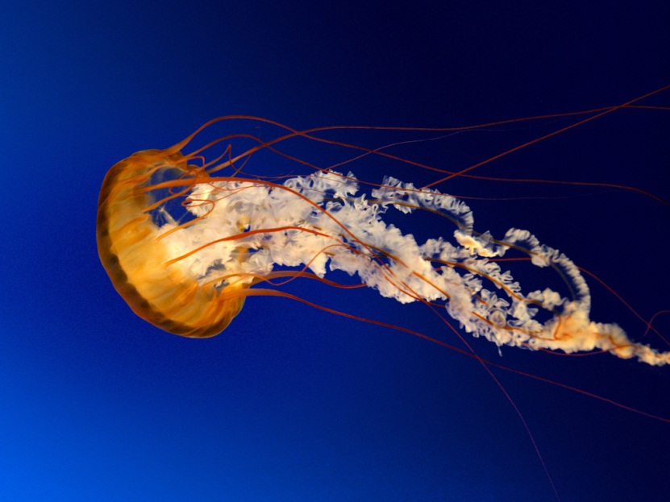
Sample
Point 1
Point 2
Point 3
Point 4
Point 5

